Slide 1
Contact Information
Instructor: Engr. Khateeb Khan
Lecturer (Software Engineering)
Department of Software Engineering NUML University, Islamabad
Email:
Office hours:
ACADEMIC BACKGROUND
BS-SE (MUST) MIRPUR, AJK
MS-SE(UET) TAXILA, PAKISTAN
PHD-SE(UET) TAXILA, PAKISTAN ( IN PROGRESS)

Slide 2
WEB 11
React JS

Slide 3
Props in JSX
In React, props (short for "properties") are used to pass data from a parent component to a child component. They enable components to be dynamic and reusable by allowing customization based on the provided values. Props might remind you of HTML attributes, but you can pass any JavaScript value through them, including objects, arrays, and functions

Slide 4
Key Features of Props in JSX
Immutable (Read-Only) Nature
Props are immutable, meaning they cannot be modified by the child component. The parent component owns and controls the data.
Unidirectional Data Flow
React follows a one-way data flow, meaning data is passed from parent to child components. The child component cannot send data back directly to the parent via props.
Passing Different Data Types
Props can accept various data types, including:
Strings
Numbers
Booleans
Arrays
Objects
Functions (Callback Functions)

Slide 5
Card js
import React from "react";
import './index.css';
import './index.js';
function Card(props)
{
return (
<div className="card">
{ props.imageUrl&& <img src={props.imageUrl} alt={props.title}
className="card-image"/>
}
<div className="card-content">
<h2 className="card-title">{props.title}</h2>
<p className="card-description">{props.descripton}</p> </div>
</div> );
}
export default Card;

Slide 6
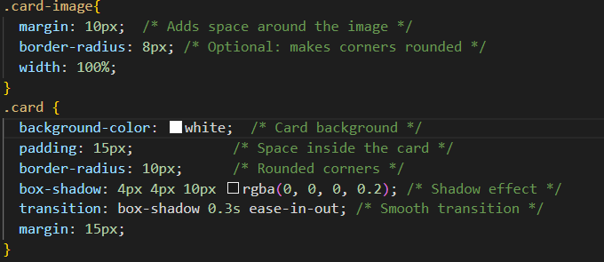
Props in JS
import React from "react";
import './index.css';
import './index.js';
function Card(props)
{
return (
<div className="card">
{ props.imageUrl&& <img src={props.imageUrl} alt={props.title}
className="card-image"/>
}
<div className="card-content">
<h2 className="card-title">{props.title}</h2>
<p className="card-description">{props.descripton}</p> </div>
</div> );
}
export default Card;

Slide 7
Card 2 js
import react from "react";
import './index.css'
import './index.js'
function Card2(props1)
{
return(
<div className="card">
{props1.imagUrl&&<img src={[props1.imagUrl]} alt={props1.imagUrl}
className="card-image"/>}
<div className="card-content">
<h1 className="card-title"> {props1.title}</h1>
<p className="card-description">{props1.content}</p>
</div> </div>
);
}
export default Card2;

Slide 8
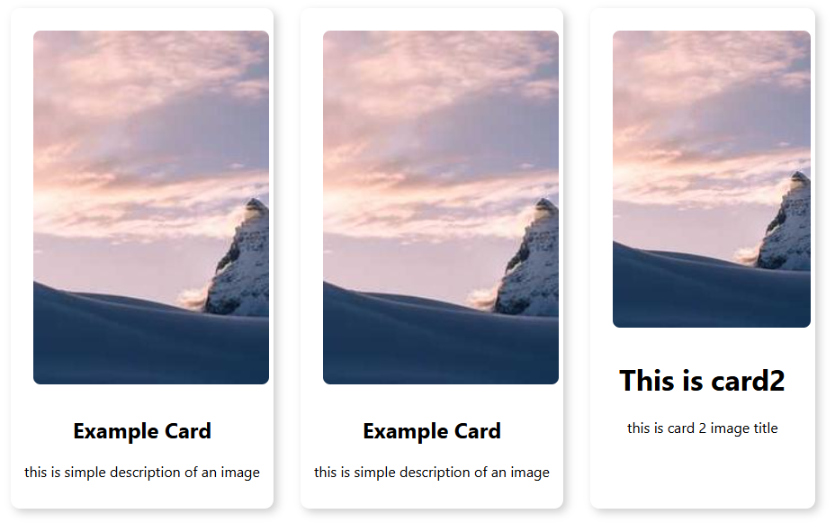
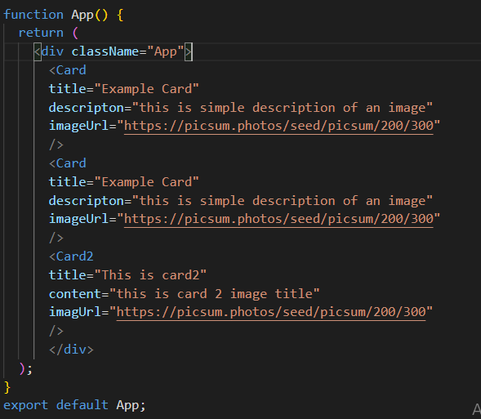
App.js

Slide 9
Arrays in React
In React, arrays are commonly used to manage and render lists of data dynamically. Since React is JavaScript-based, you can work with arrays using standard JavaScript methods like .map(), .filter(), and .reduce()
Syntax
const fruits = ["Apple", "Banana", "Orange"];

Slide 10
SDATA.JS
import React from "react";
import './index.css'
import './index.js'
const sdata=[
{ title:"card 1", description:"this is card 1",
imageURL:"https://picsum.photos/seed/picsum/200/300",
links:'https://www.google.co.uk/'
},
{title:"card 2", description:"this is card 2",
imageURL:"https://picsum.photos/seed/picsum/200/300",
links:'https://www.google.co.uk/'
},
{title:"card 3", description:"this is card 3",
imageURL:"https://picsum.photos/seed/picsum/200/300",
links:'https://www.google.co.uk/'
}
];
export default sdata;

Slide 11
CARD3.JS
import React from "react";
import './index.css';
function card3(props) {
return (
<div className="card">
{props.imageUrl && (
<img src={props.imageUrl} alt={props.title} className="card-image" />
)}
<div className="card-content">
<h2 className="card-title">{props.title}</h2>
<p className="card-description">{props.description}</p>
<a href={props.link} target="_blank" rel="noopener noreferrer">
<button className="button-click">Click Me</button>
</a>
</div>
</div>
);
}
export default card3;

Slide 12
App.js
function App() {
return (
<div className="App">
<card3
title={sdata[0].title}
description={sdata[0].description}
link={sdata[0].links}
imageUrl={sdata[0].imageURL}
/>
<card3
title={sdata[1].title}
description={sdata[1].description}
link={sdata[1].links}
imageUrl={sdata[1].imageURL}
/>
</div>
);
}
export default App;

Slide 13
App.js Map Function
function App() {
return (
<div className="App">
<div>
{sdata.map((item, index) => (
<Card3
key={index}
title={item.title}
description={item.description}
link={item.links}
imageUrl={item.imageURL}
/>
))}
In React, the .map() function is commonly used to dynamically render lists of components based on an array of data. It helps make the code more concise and maintainable.

